Slide 1

HEALTH DISCERNMENT SYSTEM
Under the guidance of
DR. ALEENA SWETAPADMA
Anish Kumar (1706200)
Indrila Basak (1706224)
Pranav Jain (1706243)
Ritam Barik (1706254)
Rituraj Saha (1706256)

Slide 2
Content
Introduction
About the diseases
Literature Survey
Motivation
Software Requirements Specifications
Requirement Analysis
Methodology and System Design
Results
Preview of the Algorithm
Conclusion
Future Scope
References

Slide 3
Introduction
The significant growth of medical images and techniques requires comprehensive and exhaustive efforts from a medical professional who is susceptible to human error and the result can also vary widely among various experts.
ML and AI techniques have been used for medical image processing and image recognition. Deep learning-based algorithms have demonstrated remarkable outcomes in the medical field with works like computer-aided diagnosis, speech recognition and so on.
In this project, we have used the above stated idea behind disease detection, to develop a system using convolutional neural network (CNN) that will help in detection of a particular disease.
The system has been made user-friendly with the help of GUI, so that it can be used not only by the medical professionals but also by the population at large.

Slide 4
About the Diseases
Malaria
Malaria is a deadly, infectious mosquito-borne disease caused by Plasmodium parasites. These parasites are transmitted by the bites of infected female Anopheles mosquitoes.
A pre-trained convolutional neural network has been used as feature extractors toward improved malaria parasite detection in thin blood smear images.
An automated process has been put forward that recognizes both the tasks of malaria parasite segmentation as well as classification.

Slide 5
Contd..
Pneumonia
Pneumonia is an infection in one or both lungs. Bacteria, viruses, and fungi causes it. The infection causes inflammation in the air sacs in the lungs, which are called alveoli.
This work mainly proposes a convolutional neural network (CNN) model to group and identify the occurrence of pneumonia disease from a given assortment of chest X-ray images.
Based on the model, disease detection from X-ray images was investigated, classifications on chest X-ray image views were performed.

Slide 6
Contd..
Breast Cancer
Breast cancer is one of the main causes of cancer death worldwide. After skin cancer, breast cancer is the most common cancer diagnosed in women but men can get breast cancer too.
In this model, classification of breast cancer histology images have been done by extracting features through a convolutional neural network (CNN) and then classifying them using a fully connected network.
This model has been tested for binary classification of the diseases with competitive experimental results.

Slide 7
Contd..
Skin Cancer
Skin cancer is an abnormal growth of skin cells. Most skin cancers are caused by exposure to ultraviolet (UV) light. When the skin is not protected, UV rays from sunlight or tanning beds can damage and alter skin's DNA that leads to the cancer.
Deep learning model has been built to classify and identify the binary diagnostic group of melanocytic images obtained through dermoscopy.
Based on the model, disease detection through dermal cell images has been investigated, and classifications on dermal cell images have been performed.

Slide 8
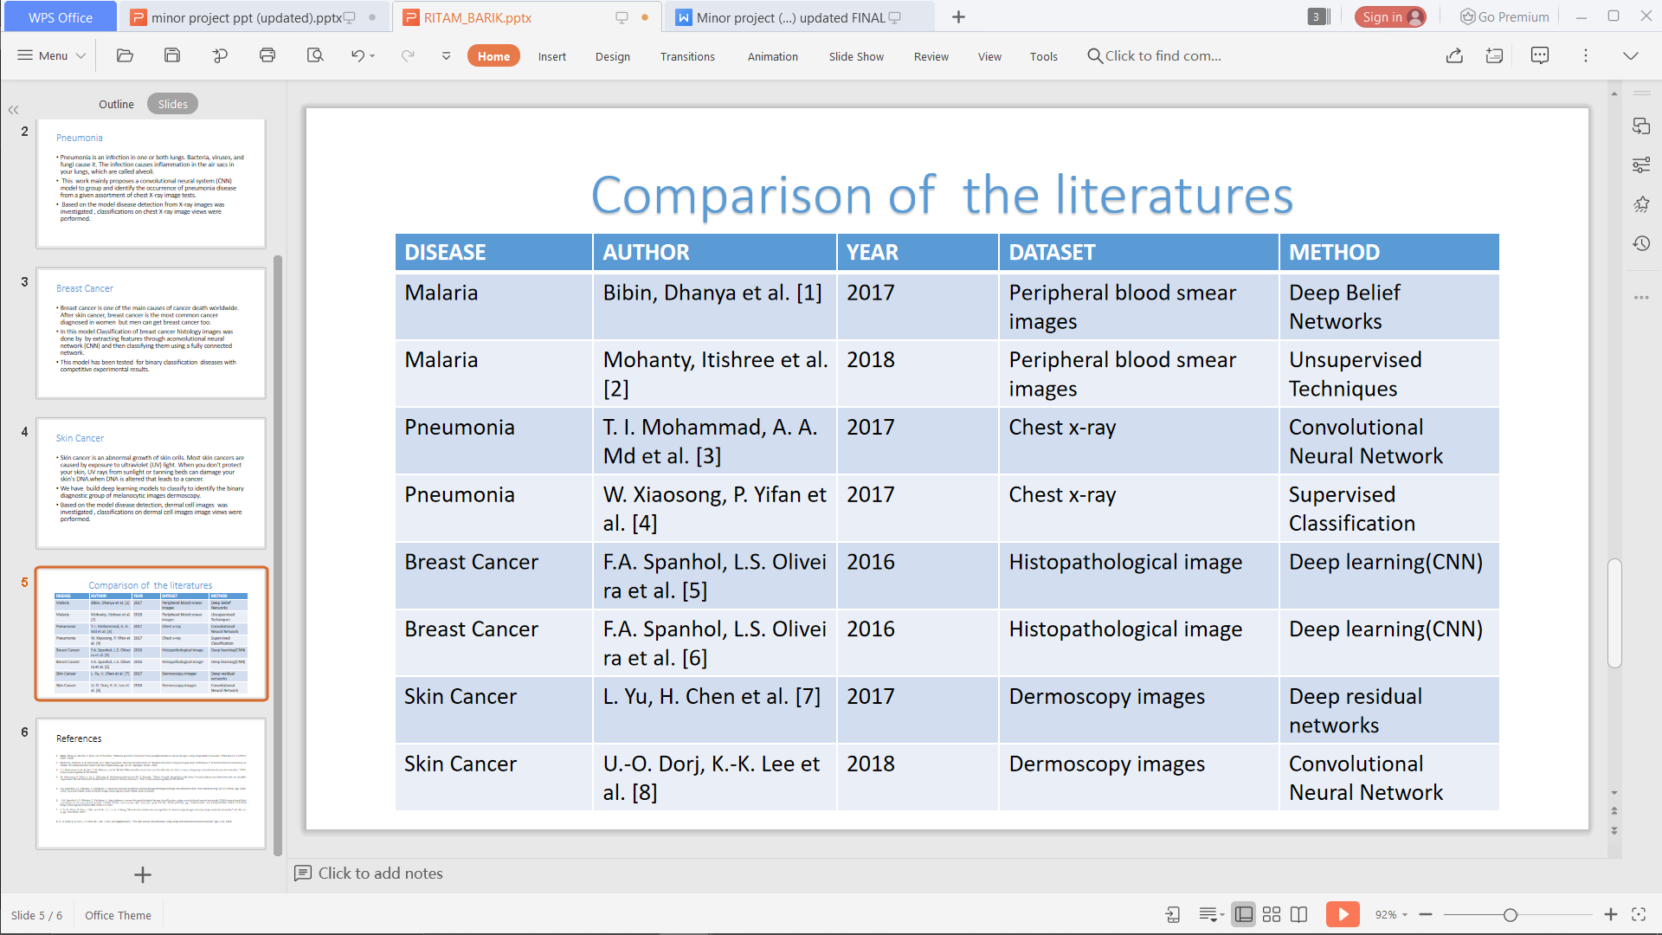
Literature Survey
Table 1. Comparison of different literatures

Slide 9
Motivation
Disease detection plays a very important role in the process of diagnosis. Therefore, the motivation lies in accurate classification and detection of the diseases based on medical images.
The main aim is to minimize the chances of error that might happen due to the doctor's misjudgement.
Developing a system that will not only help in detecting the diseases efficiently but will also save the time and effort of the medical practitioners.
This will also save the patients from running to the doctor to get their medical reports verified.

Slide 10
Software Requirements Specification
Product Scope
Product Functionality
This system will help to detect the medical results efficiently and will provide a user-friendly interface that can be used by the users.
The Health Discernment System helps not only the patients but also the health-care professionals to detect the medical test results more effectively and in a bias-free manner by computerizing the detection process.
All the functions of the system will be performed in the following order –
Upload an image
Read image
Transform image
Evaluate image using the saved model
Determine and analyse the output
Display the output

Slide 11
Contd..
Users and Characteristics
The Health Discernment System has –
one active actor (patients along with health- care professionals)
one co-operating system at the back end
Operating Environment
Operating System: Minimum Windows XP or Windows VISTA. Better environment Windows 7, 8, 8.1, 10.
Language: Python
Assumptions and Dependencies
If the user has a workstation that works on Windows OS then that person can easily use the detection interface.
The user also has to have the medical test images in JPEG, JPG or PNG format for detection purpose.

Slide 12
Requirement Analysis
Specific Requirements
EXTERNAL INTERFACE REQUIREMENTS
There are two interfaces namely – User Interface and Software Interface.
User Interface
The user interface will be implemented using any desktop running on Windows OS. This interface will be very user friendly so that people from different strata can use it to detect their disease without any difficulty by just uploading their medical test image.
Software Interface
A software interface running on Windows OS. It should have Python compiler(3.6).

Slide 13
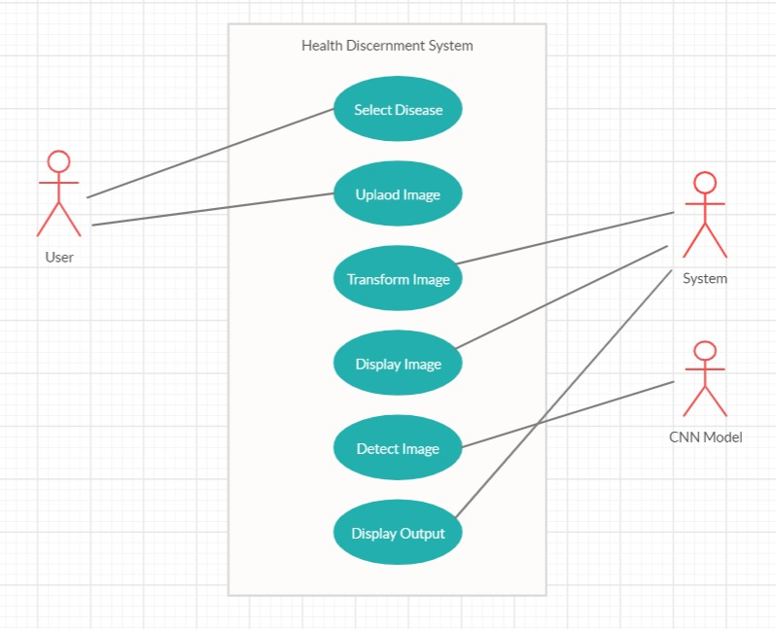
Contd..
BEHAVIOUR REQUIREMENTS
Use Case View
User Use Case
This use case will select and upload the image.
System Use Case
This use case will perform the internal operations at the backend.
Figure 1. Use Case View of the system.

Slide 14
Contd..
Non Functional Requirements
PERFORMANCE REQUIREMENTS
The product performance will be based on a local system.
Image detection will take some time.
The evaluation performance will depend on some software and hardware components.
SAFETY AND SECURITY REQUIREMENTS
The security of the predicting interface depends directly on the security of the workstation.

Slide 15
Methodology and System Design
Image Processing
Image processing can be defined as the technical analysis of an image by using complex algorithms.
The purpose of early image processing was to improve the quality of the image. Its use has been increasing exponentially in the last decades.
Its applications range from medicine to entertainment, passing by geological processing and remote sensing.

Slide 16
Contd..
Convolutional Neural Network (CNN)
A Convolutional Neural Network (CNN) is comprised of one or more convolutional layers (often with a subsampling step) and then followed by one or more fully connected layers as in a standard multilayer neural network.
The architecture of a CNN is designed to take advantage of the 2D structure of an input image. This is achieved with local connections and tied weights followed by some form of pooling which results in translation invariant features.
Another benefit of CNNs is that they are easier to train and have fewer parameters than fully connected networks with the same number of hidden units.

Slide 17
Contd..
The MVC model
Model-view-controller (MVC) is an architectural pattern widely used to design user interfaces, which divides an application into three interrelated components.
The design pattern of MVC decouples these major components to allow efficient reuse of code and also allows parallel development of each of the component.
This architecture is mostly used for desktop graphical user interfaces (GUIs) and is popular in designing web applications.
It consists of 3 components- the Model, the View and the Controller.

Slide 18
Contd..
The Model
A Model is the principal central component of an application.
The Model used in this work comprises of 4 various sub-models which represent each disease.
Malaria Detection Model
For designing the malaria disease model, a dataset has been taken comprising of cell images of 50 x 50 pixels in .png format.
The dataset is then divided into the train set and test set of 22046 and 5512 images respectively.
The custom CNN model used had 3 Convolutional layers and one fully-connected layer. ‘relu’ and ‘softmax’ activation functions are applied to the hidden layers and the output layer respectively.

Slide 19
Contd..
Pneumonia Detection Model
In the pneumonia model, a dataset comprising of chest x-rays has been taken. The images are of 224x224 pixels.
The dataset is then divided into the train set and test set of 22046 and 5512 images respectively.
CNN model having 10 convolutional layers and one fully-connected layer has been used.
For activation purpose, ‘relu’ and ‘sigmoid’ functions are used in the hidden and output layer respectively.

Slide 20
Contd..
Breast Cancer Detection Model
For this, a dataset has been taken of cell images of microanatomy that contains RGB images of 50x50 pixels.
To the dataset, a CNN model has been applied of 6 convolutional layers and one fully-connected layer.
To the output layer and the hidden layers, ‘sigmoid’ and ‘relu’ activation functions are applied respectively.

Slide 21
Contd..
Skin Cancer Detection Model
The dataset comprising of RGB images of skin samples has been taken. The images were of 224x224 pixels.
The dataset is then divided into the train set and test set of 2637 and 660 images respectively.
A CNN model of 4 convolutional layers and one fully connected layer has been developed.
For activation, ‘softmax’ and ‘relu’ are applied to the output layer and hidden layers respectively.

Slide 22
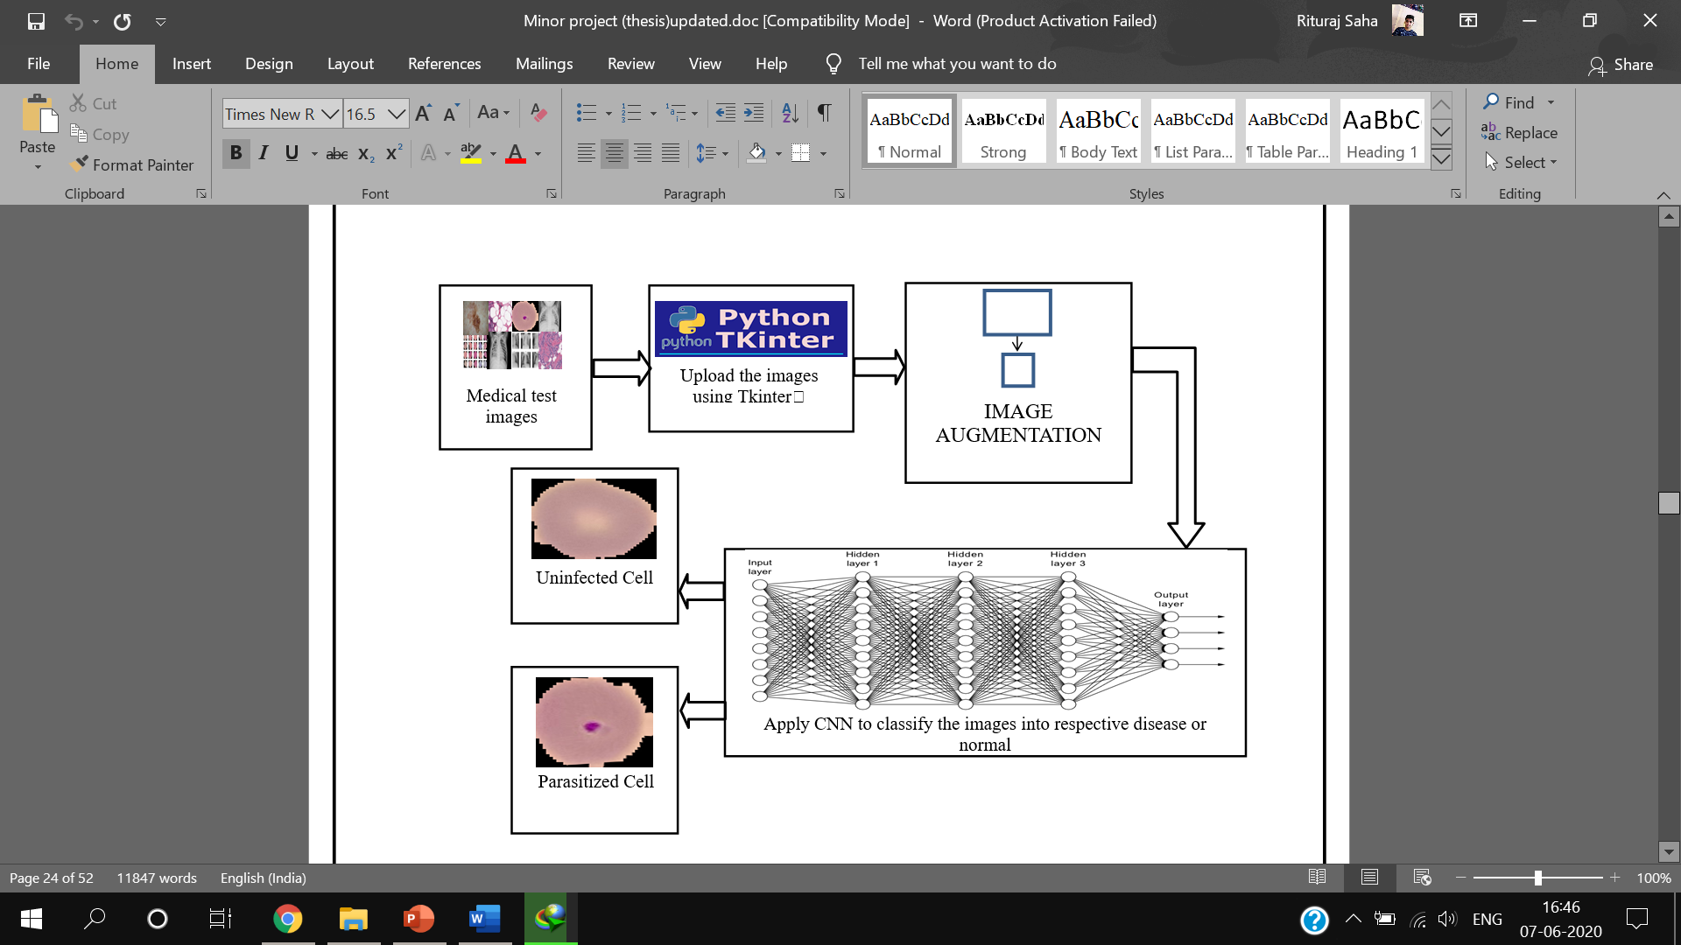
Contd..
Figure 2. Flowchart of the proposed model

Slide 23
Contd..
The View
A View is something available to the user.
It helps UI / UX people to operate in parallel with the people at the back-end of the user interface.
The Controller
A Controller is a master that synchronizes the Model along with View.
It obtains the user's interaction with the View, transmits them on to the Model that then processes the input information for output production.

Slide 24
Contd..
Implementation of MVC model in our Project
There are mainly three files in the project: main.py, detector and upload which contains the GUI, Detector and Controller components, respectively
We can alter and run the GUI component separately without compromising the functionality of the other components.
A single Controller component works for all the Views and Detectors.

Slide 25
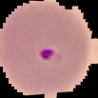
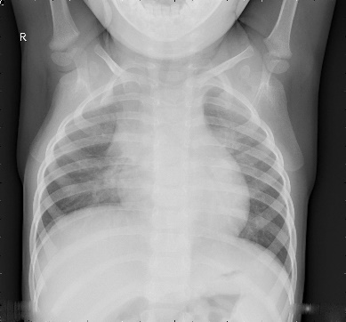
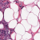
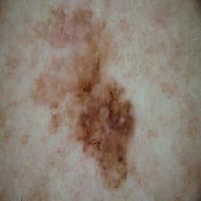
Results
Sample Test Cases
Test ID | Test Case Title | Test Condition | System Behaviour | Expected Result
T01 | Malaria Detection |  | Parasitized Cell Detected | Parasitized Cell Detected
T02 | Pneumonia Detection |  | Normal Detected | Normal Detected
T03 | Breast Cancer Detection |  | Benign Tissue Detected | Benign Tissue Detected
T04 | Skin Cancer Detection |  | Malignant Skin Detected | Malignant Skin Detected
Test Results
Test Name | Result
Malaria | 95.21%
Pneumonia | 90.06%
Breast Cancer | 86.88%
Skin Cancer | 84.6%

Slide 26
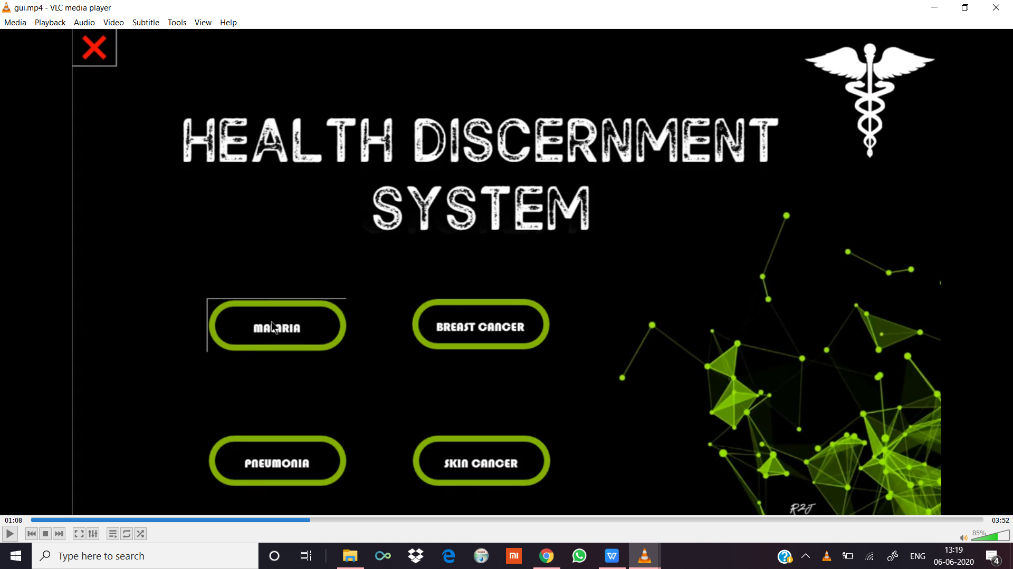
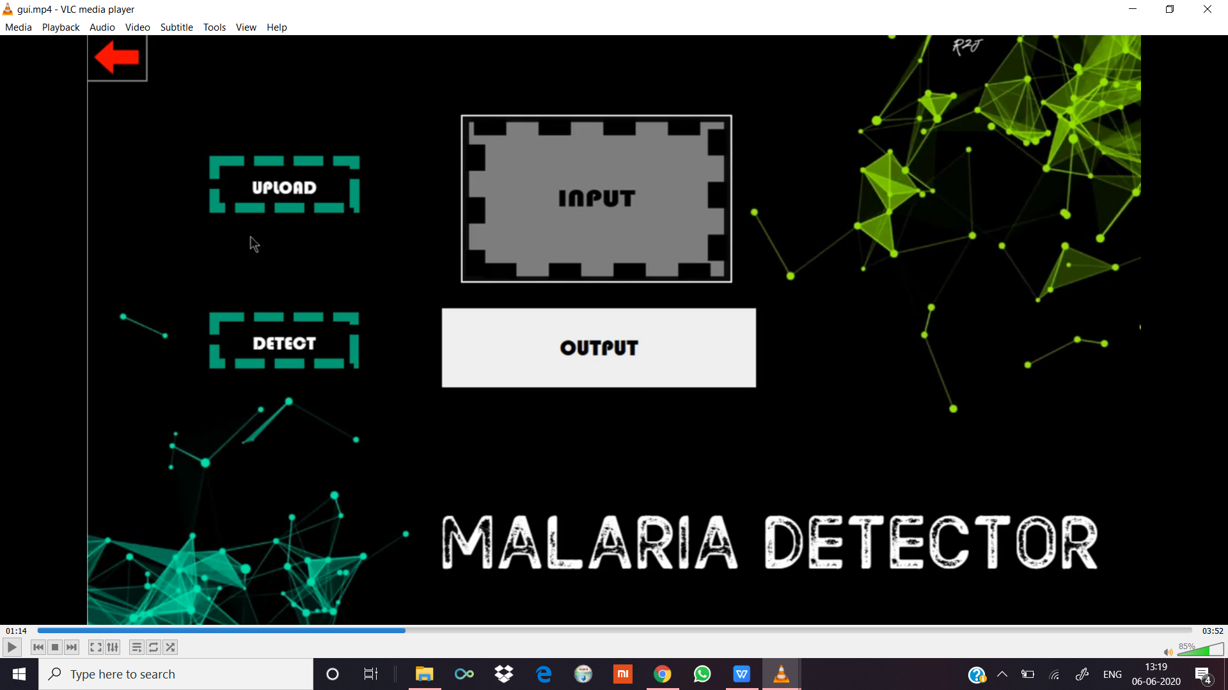
Preview of the Application
Interface 1
Interface 2
On opening the application, the opening page is displayed.
It consists of 4 buttons (one for each disease).
The user clicks on the disease they want to detect.
This page opens on selection of a particular disease.
It consists of – UPLOAD button, DETECT button, INPUT image view and, OUTPUT text view.

Slide 27
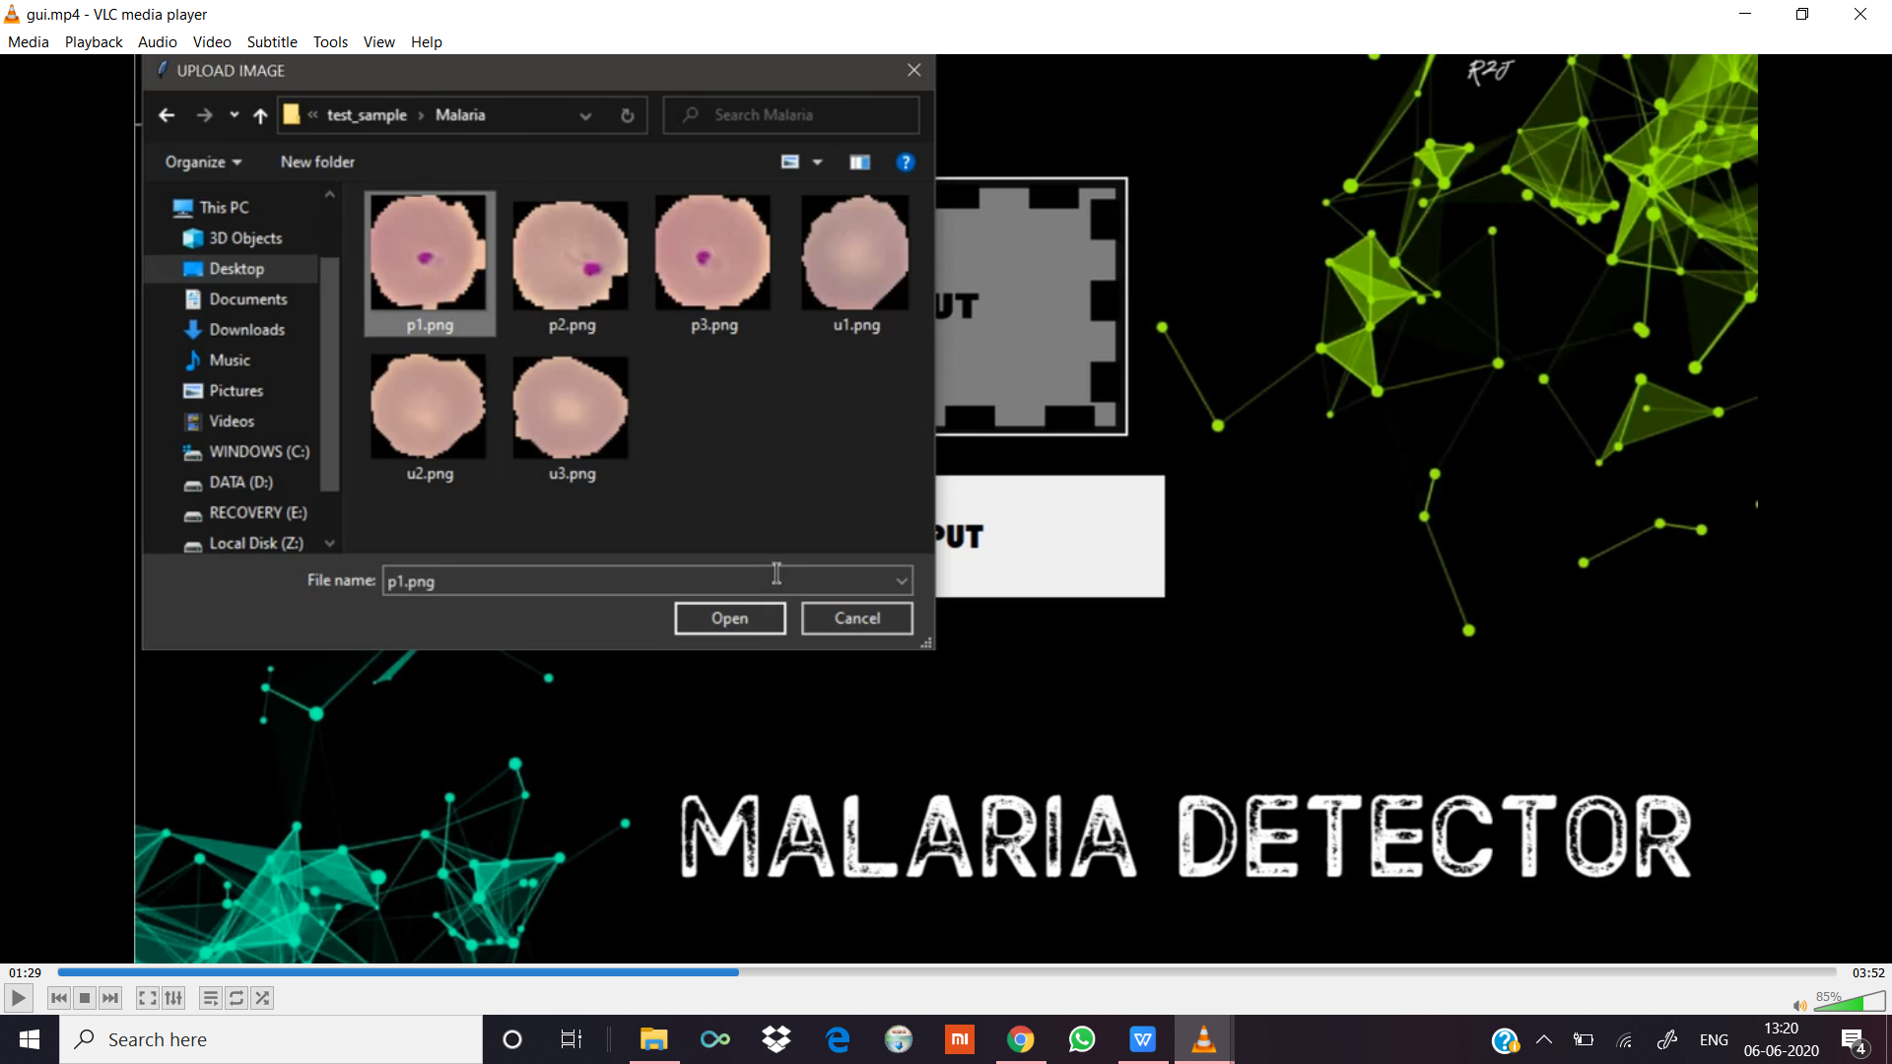
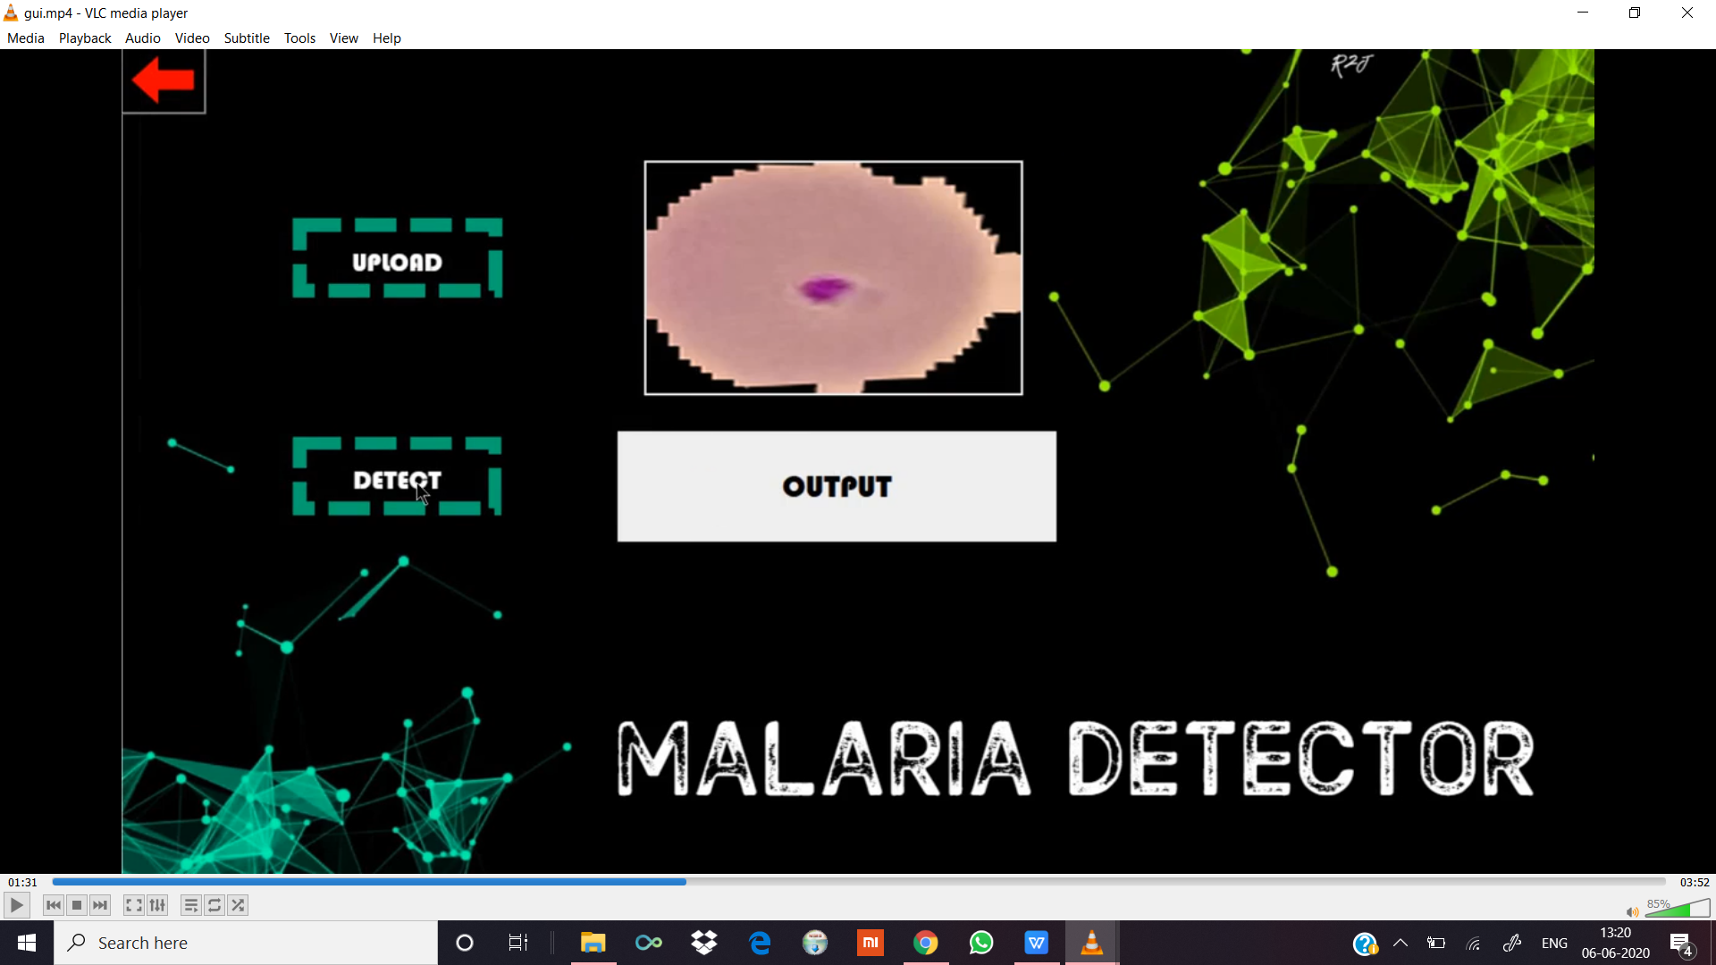
Contd..
This page opens when user clicks the UPLOAD button.
This opens a file where the user selects the image to be detected.
The selected image is displayed on screen in the INPUT image view.

Slide 28
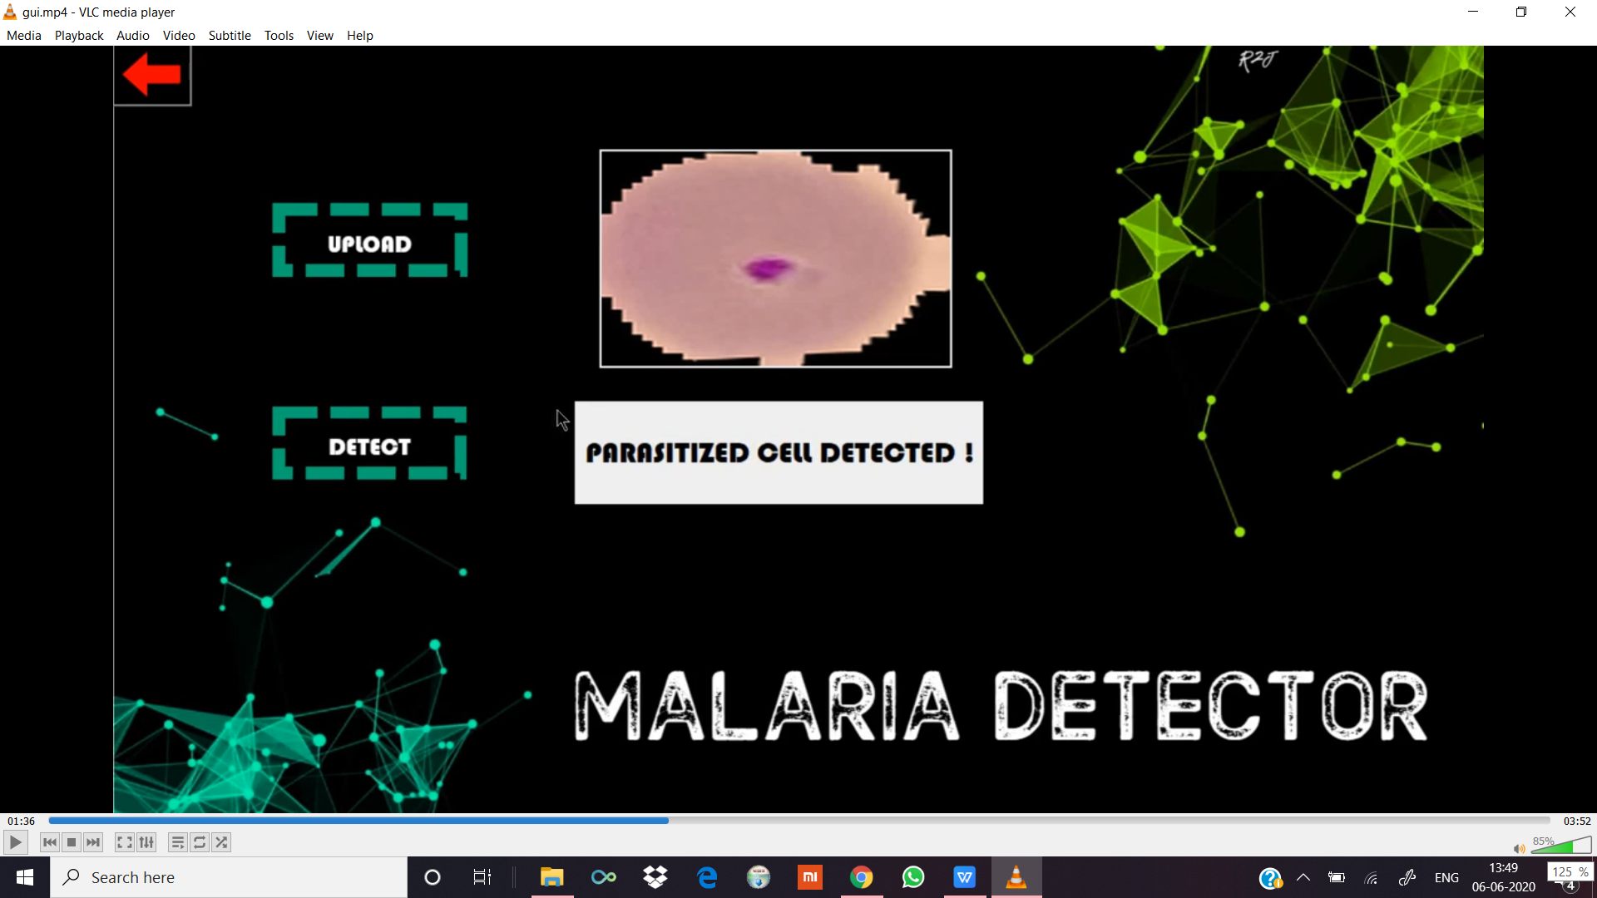
Contd..
The result is displayed at the OUTPUT text view when the user clicks on the DETECT button.

Slide 29
Conclusion
A “Health Discernment System” has been proposed for medical image classification that will work in real-life scenarios.
The proposed method is based on MVC architecture.
Different sub-models pertaining to the four diseases (malaria, pneumonia, breast cancer, and skin cancer) have been designed using convolutional neural network (CNN) and they have all been tested separately.
A GUI based web application has been designed using Tkinter so that the system can take real-life image inputs for detection.

Slide 30
Future Scope
Implementation of various other algorithms and using several optimization techniques. Also more data will be collected in order to recognize the features more accurately.
Major attention will be given to increase the accuracy such that our proposed system can be used to detect a large number of chronic and critical diseases.
When these enhancements are done, the system can be integrated with an android application to make it more convenient and easily portable. This will allow people from all strata to use it effectively even if they do not have a personal computer.

Slide 31
References
[1] Bibin, Dhanya, Madhu S. Nair, and P. Punitha. "Malaria parasite detection from peripheral blood smear images using deep belief networks." IEEE Access 5 (2017): 9099- 9108.
[2] Mohanty, Itishree, P. A. Pattanaik, and Tripti Swarnkar. "Automatic Detection of Malaria Parasites Using Unsupervised Techniques." In International Conference on ISMAC in Computational Vision and Bio-Engineering, pp. 41-49. Springer, Cham, 2018.
[3] T. I. Mohammad, A. A. Md, T. M. Ahmed, and A. Khalid,“Abnormality detection and localization in chest x-rays usingdeep convolutional neural networks,” 2017, http://arxiv.org/abs/1705.09850.
[4] W. Xiaosong, P. Yifan, L. Le, L. Zhiyong, B. Mohammadhadi,and M. S. Ronald, “Chest X-ray8: Hospital-scale chest X-raydatabase and benchmarks on weakly-supervised classiﬁcationand localization of common thorax diseases,” 2017, http://arxiv.org/abs/1705.02315
[5] F.A. Spanhol, L.S. Oliveira, C. Petitjean, L. HeutteA dataset for breast cancer histopathological image classification IEEE Trans Biomed Eng, 63 (7) (2016), pp. 1455-1462, 10.1109/TBME.2015.2496264 https://doi.org/10.1109/TBME.2015.2496264
[6] F.A. Spanhol, L.S. Oliveira, C. Petitjean, L. HeutteBreast cancer histopathological image classification using convolutional neural networks 2016 international joint conference on neural networks, IJCNN 2016, vancouver, BC, Canada, july 24-29, 2016 (2016), pp. 2560-2567, 10.1109/IJCNN.2016.7727519 https://doi.org/10.1109/IJCNN.2016.7727519
[7] L. Yu, H. Chen, Q. Dou, J. Qin, and P.-A. J. I. t. o. m. i. Heng, "Automated melanoma recognition in dermoscopy images via very deep residual networks," vol. 36, no. 4, pp. 994-1004, 2017.
[8] U.-O. Dorj, K.-K. Lee, J.-Y. Choi, M. J. M. T. Lee, and Applications, "The skin cancer classification using deep convolutional neural network," pp. 1-16, 2018.
[9] www.kaggle.com - The world's largest data science community
[10] www.tensorflow.org - open-source machine-learning platform

Slide 32
Thank You!

